Slide 1
POWER BI PROJECT 2
DONE BY : DAIGA GIMA GWANFOGBE

Slide 2
Set Up Relationships and Data Transformations
-Link the Stock table and Orders table using the SKU or SKU-ID column
-Ensure the relationships are set to Many-to-One.
-Calculate Total Sales for Each Product
-Calculate Remaining Stock
-Calculate Stock Turnover Ratio
-Create a Rank Measure for sales to Identify Best-Selling Products

Slide 3
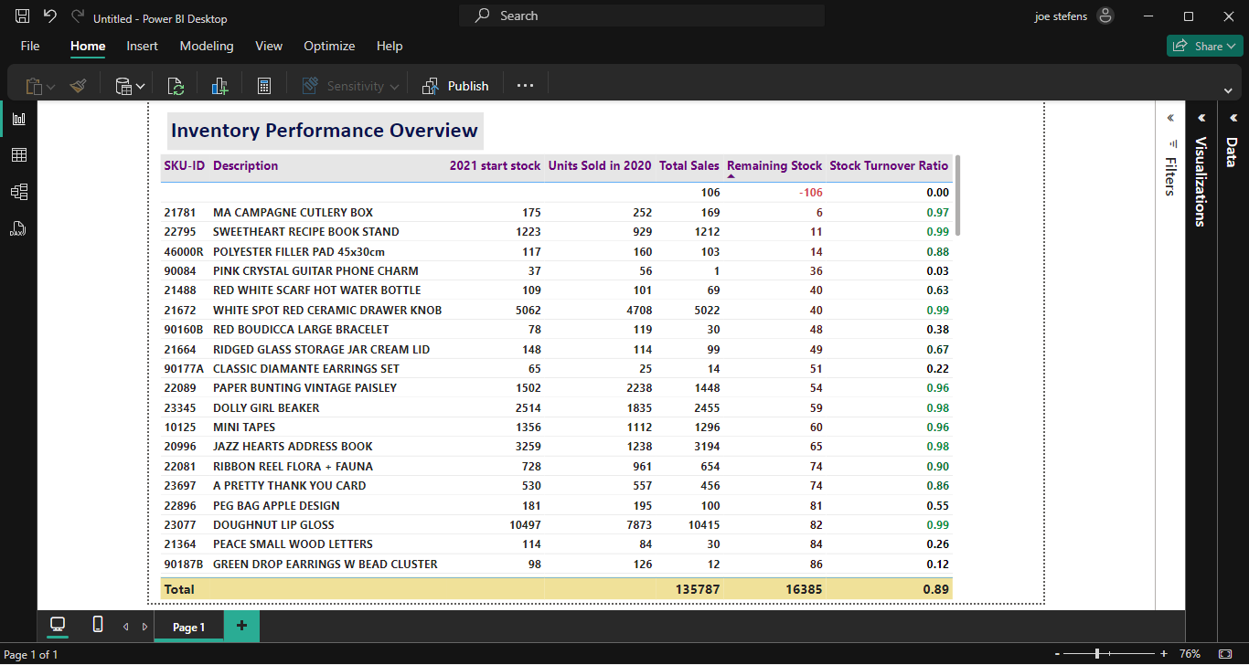
Visualizing the Data
1) Inventory Performance Overview:
Notes:
Low Remaining Stock in red and high Stock Turnover Ratio in green.

Slide 4
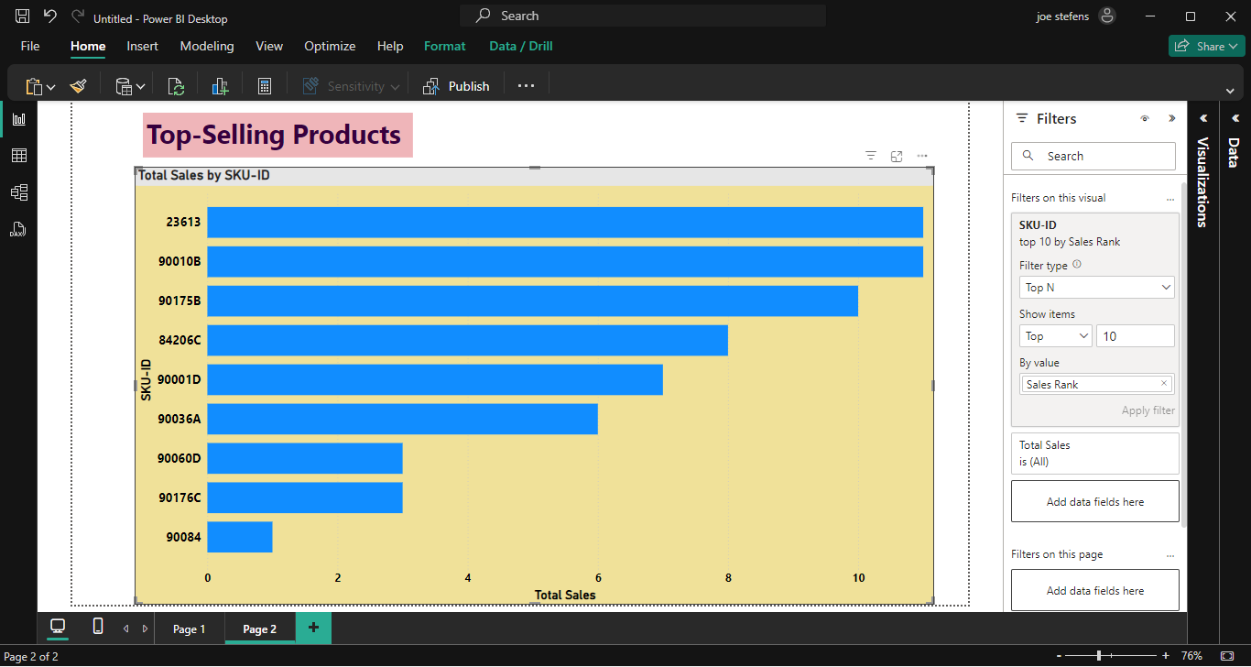
2) Top-Selling Products
Notes:
Filter to show top 10 products by Sales Rank

Slide 5
-Key Metrics
-Profitability vs. Turnover
-KPI Visuals for Total Units Sold, Profitability vs. turnover
-Bubble Size (Remaining Inventory) indicates the stock level. Larger bubbles mean more inventory is available.
-The goal is to find fast-moving, high-profit items (top-right region) and low-stock, high-turnover items (small bubbles in the right half).
-Also, overstocked, slow-moving items (large bubbles in the left half).

Slide 6
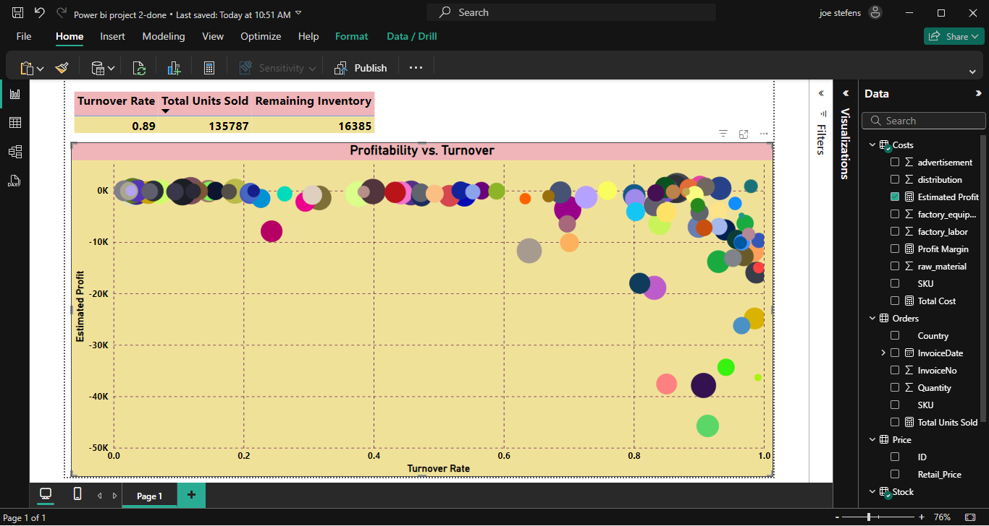
Visualization
Analyze high-profit, fast-moving items.

Slide 7
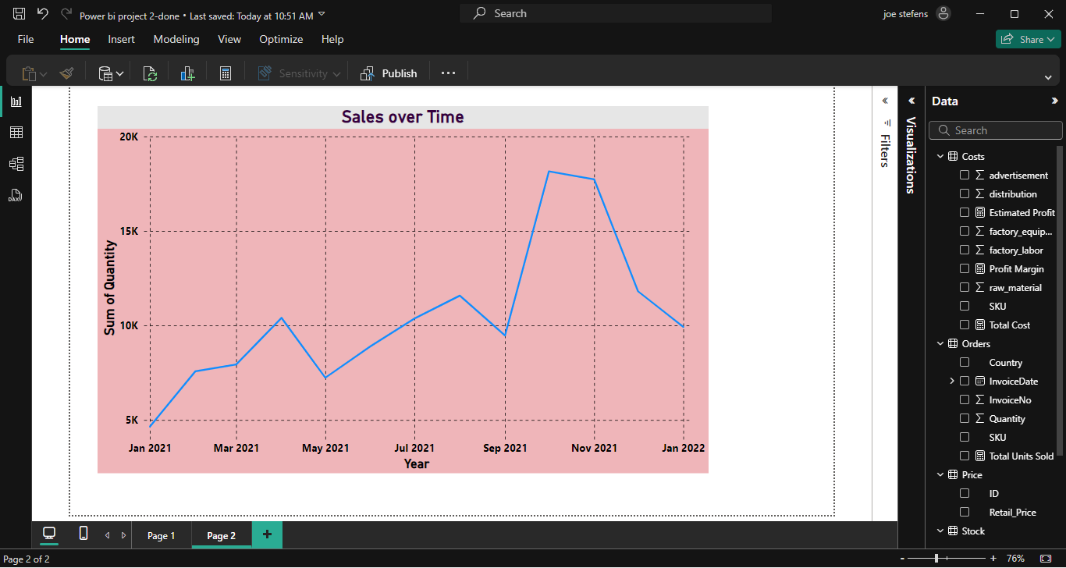
Demand Trends: sales over time
Seasonal Trends: Analyze sales(Quantity) over time (InvoiceDate) to detect patterns in demand or top selling items.

Slide 8
Insights & Recommendations
Analyze visualizations to:
-Identify items with strong sales and low remaining stock for immediate restocking.
-Spot overstocked items with minimal sales to reduce future inventory.
-Optimize profitability by focusing on high-margin products.

